Slide 1
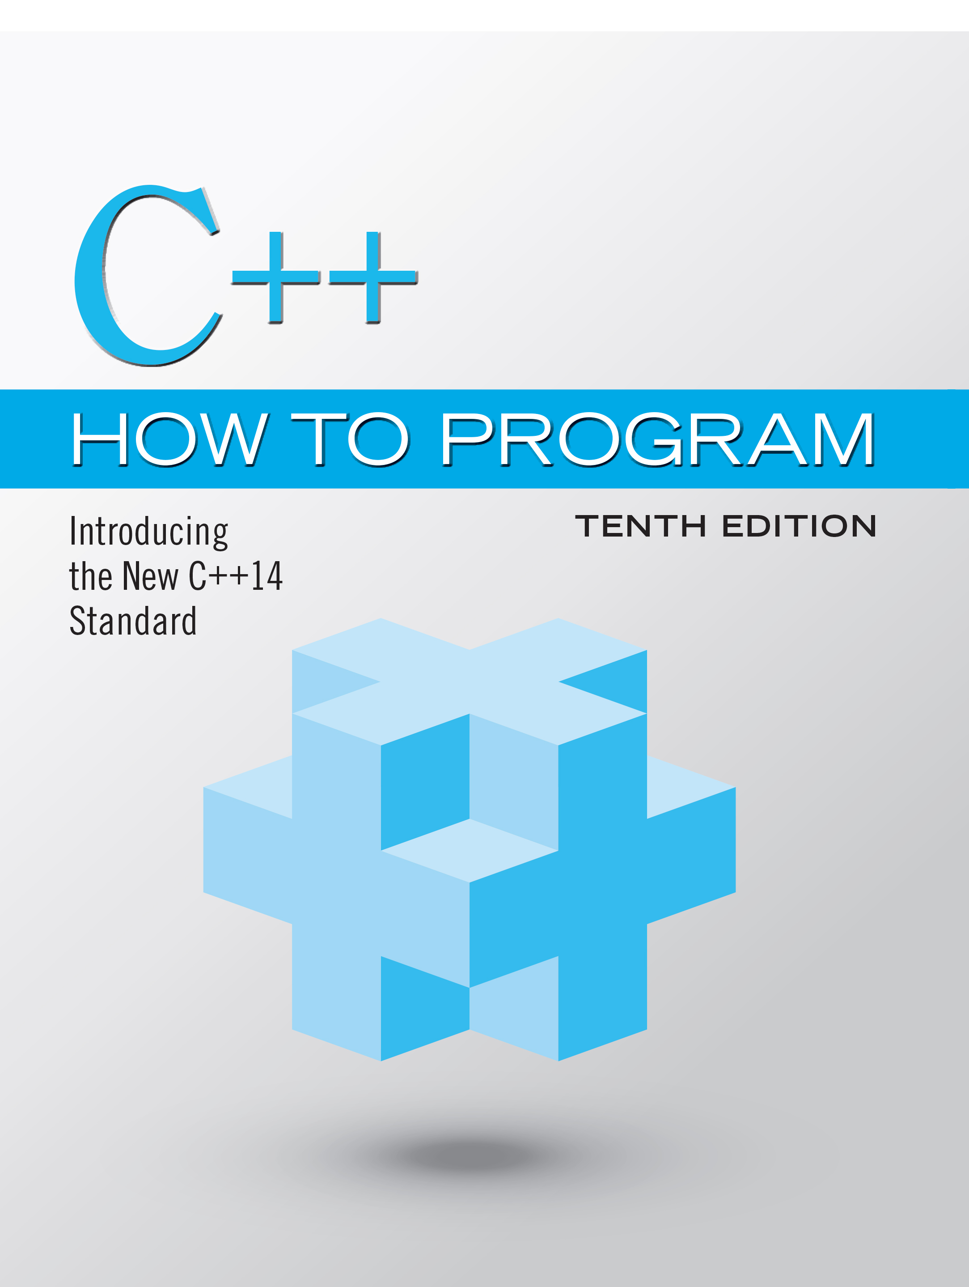
C++ How to Program: Introducing the New C++14 Standard
Tenth Edition
Chapter 6
Functions and an Introduction to Recursion
Copyright © 2017, 2014, 2012 Pearson Education, Inc. All Rights Reserved
Notes:
If this PowerPoint presentation contains mathematical equations, you may need to check that your computer has the following installed:
1) MathType Plugin
2) Math Player (free versions available)
3) NVDA Reader (free versions available)

Slide 2
Learning Objectives (1 of 2)
Construct programs modularly from functions.
Use common math library functions.
Use function prototypes to declare a function.
Use random-number generation to implement game-playing applications.
Use C++14 digit separators to make numeric literals more readable
Understand how the visibility of identifiers is limited to specific regions of programs.

Slide 3
Learning Objectives (2 of 2)
Understand how the function call/return mechanism is supported by the function-call stack and activation records.
Understand the mechanisms for passing data to functions and returning results.
Use inline functions, references and default arguments.
Define with the same name overloaded functions that perform different tasks based on the number and types of their arguments.
Define function templates that can generate families of overloaded functions.
Write and use recursive functions.

Slide 4
Outline (1 of 4)
6.1 Introduction
6.2 Program Components in C++
6.3 Math Library Functions
6.4 Function Prototypes
6.5 Function-Prototype and Argument-Coercion Notes
6.5.1 Function Signatures and Function Prototypes
6.5.2 Argument Coercion
6.5.3 Argument-Promotion Rules and Implicit Conversions

Slide 5
Outline (2 of 4)
6.6 C++ Standard Library Headers
6.7 Case Study: Random-Number Generation
6.7.1 Rolling a Six-Sided Die
6.7.2 Rolling a Six-Sided Die 60,000,000 Times
6.7.3 Randomizing the Random-Number Generator with srand
6.7.4 Seeding the Random-Number Generator with the Current Time
6.7.5 Scaling and Shifting Random Numbers

Slide 6
Outline (3 of 4)
6.8 Case Study: Game of Chance; Introducing Scoped enums
6.9 C++11 Random Numbers
6.10 Scope Rules
6.11 Function-Call Stack and Activation Records
6.12 Inline Functions
6.13 References and Reference Parameters
6.14 Default Arguments

Slide 7
Outline (4 of 4)
6.15 Unary Scope Resolution Operator
6.16 Function Overloading
6.17 Function Templates
6.18 Recursion
6.19 Example Using Recursion: Fibonacci Series
6.20 Recursion vs. Iteration
6.21 Wrap-Up

Slide 8
6.1 Introduction (1 of 2)
Develop and maintain a large program by constructing it from small, simple pieces, or components.
divide and conquer.
Emphasize how to declare and use functions to facilitate the design, implementation, operation and maintenance of large programs.
Function prototypes and how the compiler uses them to convert the type of an argument in a function call to the type specified in a function’s parameter list, if necessary.
Simulation techniques with random number generation.
C++’s scope rules.

Slide 9
6.1 Introduction (2 of 2)
How C++ keeps track of which function is currently executing, how parameters and other local variables of functions are maintained in memory and how a function knows where to return after it completes execution.
Function overloading.
Function templates.
Recursion.

Slide 10
6.2 Program Components in C++ (1 of 3)
C++ programs are typically written by combining “prepackaged” functions and classes available in the C++ Standard Library with new functions and classes you write.
The C++ Standard Library provides a rich collection of functions.
Functions allow you to modularize a program by separating its tasks into self-contained units.

Slide 11
Software Engineering Observation 6.1
To promote software reusability, every function should be limited to performing a single, well-defined task, and the name of the function should express that task effectively.

Slide 12
6.2 Program Components in C++ (2 of 3)
A function is invoked by a function call, and when the called function completes its task, it either returns a result or simply returns control to the caller.
An analogy is the hierarchical form of management (Figure 6.1).
A boss (similar to the calling function) asks a worker (similar to the called function) to perform a task and report back (i.e., return) the results after completing the task.
The boss does not know how the worker performs its tasks.
The worker may also call other workers, unbeknownst to the boss.

Slide 13
6.2 Program Components in C++ (3 of 3)
This hiding of implementation details promotes good software engineering.
The relationship does not need to be hierarchical, but often it is, which makes it easier to test, debug, update and maintain programs.

Slide 14
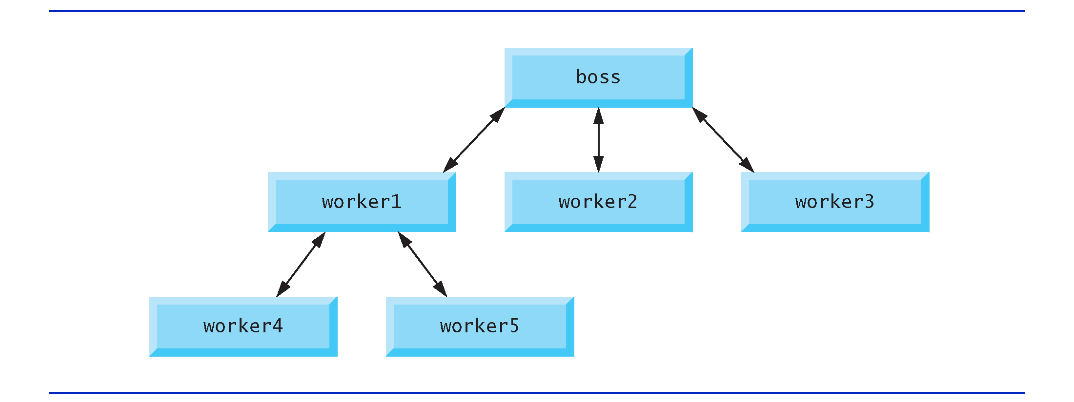
Figure 6.1 Hierarchical Boss-Function/Worker-Function Relationship

Slide 15
6.3 Math Library Functions (1 of 2)
Sometimes functions are not members of a class.
Called global functions.
The <cmath> header provides a collection of functions that enable you to perform common mathematical calculations.
All functions in the <cmath> header are global functions—therefore, each is called simply by specifying the name of the function followed by parentheses containing the function’s arguments.

Slide 16
Error-Prevention Tip 6.1
Do not call sqrt with a negative argument. For industrial-strength code, always check that the arguments you pass to math functions are valid.

Slide 17
6.3 Math Library Functions (2 of 2)
Some math library functions are summarized in Figure 6.2.
In the figure, the variables x and y are of type double.

Slide 18
Figure 6.2 Math Library Functions (1 of 2)
Function | Description | Example
ceil(x) | rounds x to the smallest integer not less than x | ceil(9.2) is 10.0 ceil(-9.8) is -9.0
cos(x) | trigonometric cosine of x (x in radians) | cos(0.0) is 1.0
exp(x) | exponential function e to the x power | exp(1.0) is 2.718282 exp(2.0) is 7.389056
fabs(x) | absolute value of x | fabs(5.1) is 5.1 fabs(0.0) is 0.0 fabs(-8.76) is 8.76
floor(x) | rounds x to the largest integer not greater than x | floor(9.2) is 9.0 floor(-9.8) is -10.0
fmod(x, y) | remainder of X forward slash y as a floating-point number | fmod(2.6, 1.2) is 0.2

Slide 19
Figure 6.2 Math Library Functions (2 of 2)
Function | Description | Example
log(x) | natural logarithm of x (base e) | log(2.718282) is 1.0 log(7.389056) is 2.0
log10(x) | logarithm of x (base 10) | log10(10.0) is 1.0 log10(100.0) is 2.0
pow(x, y) | x raised to power Y of X to the y power | pow(2, 7) is 128 pow(9, .5) is 3
sin(x) | trigonometric sine of x (x in radians) | sin(0.0) is 0
sqrt(x) | square root of x (where x is a nonnegative value) | sqrt(9.0) is 3.0
tan(x) | trigonometric tangent of x (x in radians) | tan(0.0) is 0

Slide 20
6.4 Function Pototypes (1 of 5)
In this section, we create a user-defined function called maximum (Figure 6.3) that returns the largest of its three int arguments.

Slide 21
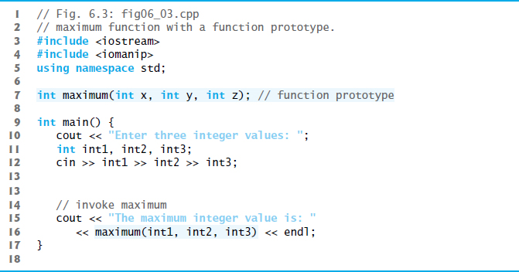
Figure 6.3 maximum Function with a Function Prototype (1 of 3)

Slide 22
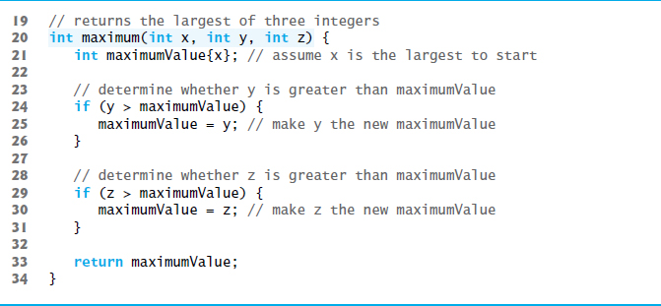
Figure 6.3 maximum Function with a Function Prototype (2 of 3)

Slide 23
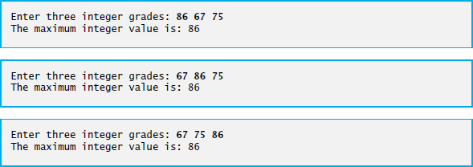
Figure 6.3 maximum Function with a Function Prototype (3 of 3)

Slide 24
6.4 Function Prototypes (2 of 5)
In preceding chapters, we created classes with various member functions.
We defined each class in a header (.h) and included it before main in a program’s source-code file.
Doing this ensures that the class (and thus its member functions) is defined before main creates and manipulates objects of that class.
The compiler then can ensure that we call each class’s constructors and member functions correcly—for example, passing each the correct number and types of arguments.

Slide 25
6.4 Function Prototypes (3 of 5)
For a function not defined in a class, you must either define the function before using it or you must declare that the function exists, as we do in line 7 of Figure 6.3:
int maximum(int x, int y, int z); // function prototype
This is a function prototype, which describes the maximum function without revealing its implementation.

Slide 26
6.4 Function Prototypes (4 of 5)
A function prototype is a declaration of a function
tells the compiler the function’s name, its return type and the types of its parameters.
This function prototype indicates that the function returns an int, has the name maximum and requires three int parameters to perform its task.
The function prototype is the same as the first line of the corresponding function definition (line 20), but ends with a required semicolon.

Slide 27
Good Programming Practice 6.1
Parameter names in function prototypes are optional (they’re ignored by the compiler), but many programmers use these names for documentation purposes. We used parameter names in Figure 6.3’s function prototype for demonstration purposes, but generally we do not use them in this book’s subsequent examples.

Slide 28
6.4 Function Prototypes (5 of 5)
When compiling the program, the compiler uses the prototype to
Ensure that maximum’s first line matches its prototype.
Check that the call to maximum contains the correct number and types of arguments, and that the types of the arguments are in the correct order.
Ensure that the value returned by the function can be used correctly in the expression that called the function.
Ensure that each argument is consistent with the type of the corresponding parameter.
If the arguments passed to a function do not match the types specified in the function’s prototype, the compiler attempts to convert the arguments to those types.

Slide 29
Common Programming Error 6.1
Declaring function parameters of the same type as int x, y instead of int x, int y is a syntax error—a type is required for each parameter in the parameter list.

Slide 30
Common Programming Error 6.2
Compilation errors occur if the function prototype, header and calls do not all agree in the number, type and order of arguments and parameters, and in the return type.

Slide 31
Software Engineering Observation 6.2
A function that has many parameters may be performing too many tasks. Consider dividing the function into smaller functions that perform the separate tasks. Limit the function header to one line if possible.

Slide 32
6.4 Function Prototypes (3 of 3)
Multiple parameters are specified in both the function prototype and the function header as a comma-separated list, as are multiple arguments in a function call.

Slide 33
Portability Tip 6.1
The commas used in line 16 of Figure 6.3 to separate the arguments to function maximum are not comma operators as discussed in Section 5.5. The comma operator guarantees that its operands are evaluated left to right. The order of evaluation of a function’s arguments, however, is not specified by the C++ standard. Thus, different compilers can evaluate function arguments in different orders.

Slide 34
Portability Tip 6.2
Sometimes when a function’s arguments are expressions, such as those with calls to other functions, the order in which the compiler evaluates the arguments could affect the values of one or more of the arguments. If the evaluation order changes between compilers, the argument values passed to the function could vary, causing subtle logic errors.

Slide 35
Error-Prevention Tip 6.2
If you have doubts about the order of evaluation of a function’s arguments and whether the order would affect the values passed to the function, evaluate the arguments in separate assignment statements before the function call, assign the result of each expression to a local variable, then pass those variables as arguments to the function.

Slide 36
6.4 Function Definitions with Multiple Parameters
In a function that does not return a result (i.e., it has a void return type), we showed that control returns when the program reaches the function-ending right brace.
You also can explicitly return control to the caller by executing the statement
return;

Slide 37
6.5 Function-Prototypes and Argument-Coercion Notes
A function prototype is required unless the function is defined before it’s used.
When you use a standard library function like sqrt, you do not have access to the function’s definition, therefore it cannot be defined in your code before you call the function.
Instead, you must include its corresponding header (<cmath>), which contains the function’s prototype.

Slide 38
Common Programming Error 6.3
If a function is defined before it’s called, then its definition also serves as the function’s prototype, so a separate prototype is unnecessary. If a function is called before it’s defined, and that function does not have a function prototype, a compilation error occurs.

Slide 39
Software Engineering Observation 6.3
Always provide function prototypes, even though it’s possible to omit them when functions are defined before they’re used. Providing the prototypes avoids tying the code to the order in which functions are defined (which can easily change as a program evolves).

Slide 40
6.5.1 Function Signatures and Function Prototypes
The portion of a function prototype that includes the name of the function and the types of its arguments is called the function signature or simply the signature.
Signature does not specify the function’s return type.
The scope of a function is the region of a program in which the function is known and accessible.

Slide 41
Error-Prevention Tip 6.3
Function prototypes help you find many types of errors at compile time. It’s always better to eliminate errors at compile time rather than at run time.

Slide 42
6.5.2 Argument Coercion
An important feature of function prototypes is argument coercion
forcing arguments to the appropriate types specified by the parameter declarations.
These conversions occur as specified by C++’s promotion rules.

Slide 43
6.5.3 Argument-Promotion Rules and Implicit Conversions (1 of 2)
The promotion rules indicate how to convert between types without losing data.
The promotion rules apply to expressions containing values of two or more data types
also referred to as mixed-type expressions.
The type of each value in a mixed-type expression is promoted to the “highest” type in the expression.

Slide 44
6.5.3 Argument-Promotion Rules and Implicit Conversions (2 of 2)
Figure 6.4 lists the arithmetic data types in order from “highest type” to “lowest type.”
Converting values to lower fundamental types can result in incorrect values.
Therefore, a value can be converted to a lower fundamental type only by explicitly assigning the value to a variable of lower type or by using a cast operator.

Slide 45
Figure 6.4 Promotion Hierarchy for Arithmetic Data Types; The “Highest” Types are at the Top
Data types
long double | Blank
double | Blank
float | Blank
unsigned long long int | (synonymous with unsigned long long)
long long int | (synonymous with long long)
unsigned long int | (synonymous with unsigned long)
long int | (synonymous with long)
unsigned int | (synonymous with unsigned)
int | Blank
unsigned short int | (synonymous with unsigned short)
short int | (synonymous with short)
unsigned char | Blank
char and signed char | Blank
bool | Blank

Slide 46
Common Programming Error 6.4
A compilation error occurs if the arguments in a function call cannot be implicitly converted to the expected types specified in the function’s prototype.

Slide 47
6.6 C++ Standard Library Header Files
The C++ Standard Library is divided into many portions, each with its own header file.
The header files contain the function prototypes for the related functions that form each portion of the library.
The header files also contain definitions of various class types and functions, as well as constants needed by those functions.
A header file “instructs” the compiler on how to interface with library and user-written components.
Figure 6.5 lists some common C++ Standard Library header files, most of which are discussed later in the book.

Slide 48
Figure 6.5 C++ Standard Library Headers (1 of 4)
Standard Library header | Explanation
<iostream> | Contains function prototypes for the C++ standard input and output functions, introduced in Chapter 2, and is covered in more detail in Chapter 13, Stream Input/Output: A Deeper Look.
<iomanip> | Contains function prototypes for stream manipulators that format streams of data. This header is first used in Section 4.10 and is discussed in more detail in Chapter 13, Stream Input/Output: A Deeper Look.
<cmath> | Contains function prototypes for math library functions (Section 6.3).
<cstdlib> | Contains function prototypes for conversions of numbers to text, text to numbers, memory allocation, random numbers and various other utility functions. Portions of the header are covered in Section 6.7; Chapter 11, Operator Overloading; Class string; Chapter 17, Exception Handling: A Deeper Look; Chapter 22, Bits, Characters, C Strings and structs; and Appendix F, C Legacy Code Topics.
<ctime> | Contains function prototypes and types for manipulating the time and date. This header is used in Section 6.7.

Slide 49
Figure 6.5 C++ Standard Library Headers (2 of 4)
Standard Library header | Explanation
<array>, <vector>, <list>, <forward_list>, <deque>, <queue>, <stack>, <map>, <unordered_map>, <unordered_set>, <set>, <bitset> | These headers contain classes that implement the C++ Standard Library containers. Containers store data during a program’s execution. The <vector> header is first introduced in Chapter 7, Class Templates array and vector; Catching Exceptions. We discuss all these headers in Chapter 15, Standard Library Containers and Iterators. <array>, <forward_list>, <unordered_map> and <unordered_set> were all introduced in C++11.
<cctype> | Contains function prototypes for functions that test characters for certain properties (such as whether the character is a digit or a punctuation), and function prototypes for functions that can be used to convert lowercase letters to uppercase letters and vice versa. These topics are discussed in Chapter 22, Bits, Characters, C Strings and structs.
<cstring> | Contains function prototypes for C-style string-processing functions. This header is used in Chapter 10, Operator Overloading; Class string.

Slide 50
Figure 6.5 C++ Standard Library Headers (3 of 4)
Standard Library Header | Explanation
<typeinfo> | Contains classes for runtime type identification (determining data types at execution time). This header is discussed in Section 12.9.
<exception>, <stdexcept> | These headers contain classes that are used for exception handling (discussed in Chapter 17, Exception Handling: A Deeper Look).
<memory> | Contains classes and functions used by the C++ Standard Library to allocate memory to the C++ Standard Library containers. This header is used in Chapter 17, Exception Handling: A Deeper Look.
<fstream> | Contains function prototypes for functions that perform input from and output to files on disk (discussed in Chapter 14, File Processing).
<string> | Contains the definition of class string from the C++ Standard Library (discussed in Chapter 21, Class string and String Stream Processing).
<sstream> | Contains function prototypes for functions that perform input from strings in memory and output to strings in memory (discussed in Chapter 21, Class string and String Stream Processing).
<functional> | Contains classes and functions used by C++ Standard Library algorithms. This header is used in Chapter 15.

Slide 51
Figure 6.5 C++ Standard Library Headers (4 of 4)
Standard Library header | Explanation
<iterator> | Contains classes for accessing data in the C++ Standard Library containers. This header is used in Chapter 15.
<algorithm> | Contains functions for manipulating data in C++ Standard Library containers. This header is used in Chapter 15.
<cassert> | Contains macros for adding diagnostics that aid program debugging. This header is used in Appendix E, Preprocessor.
<cfloat> | Contains the floating-point size limits of the system.
<climits> | Contains the integral size limits of the system.
<cstdio> | Contains function prototypes for the C-style standard input/output library functions.
<locale> | Contains classes and functions normally used by stream processing to process data in the natural form for different languages (e.g., monetary formats, sorting strings, character presentation, etc.).
<limits> | Contains classes for defining the numerical data type limits on each computer platform—this is C++’s version of <climits> and <cfloat>.
<utility> | Contains classes and functions that are used by many C++ Standard Library headers.

Slide 52
6.7 Case Study: Random Number Generation (1 of 3)
The element of chance can be introduced into computer applications by using the C++ Standard Library function rand.
The function rand generates an unsigned integer between 0 and RAND_MAX (a symbolic constant defined in the <cstdlib> header file).

Slide 53
6.7 Case Study: Random Number Generation (2 of 3)
The value of RAND_MAX must be at least 32767—the maximum positive value for a two-byte (16-bit) integer.
For G N U C++, the value of RAND_MAX is 2147483647; for Visual Studio, the value of RAND_MAX is 32767.
If rand truly produces integers at random, every number between 0 and RAND_MAX has an equal chance (or probability) of being chosen each time rand is called.

Slide 54
6.7.1 Rolling a Six-Sided Die
The function prototype for the rand function is in <cstdlib>.
To produce integers in the range 0 to 5, we use the modulus operator (%) with rand:
rand() % 6
This is called scaling.
The number 6 is called the scaling factor. Six values are produced.
We can shift the range of numbers produced by adding a value.

Slide 55
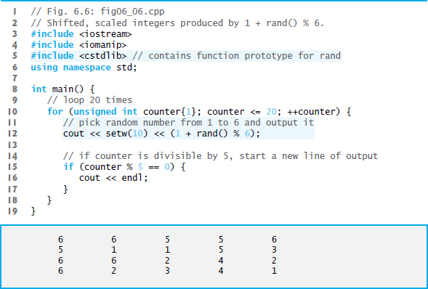
Figure 6.6 Shifted, Scaled Integers Produced by 1 + rand() % 6

Slide 56
6.7.2 Rolling a Six-Sided Die 60,000,000 Times (1 of 2)
To show that the numbers produced by rand occur with approximately equal likelihood, Figure 6.7 simulates 60,000,000 rolls of a die.
Each integer in the range 1 to 6 should appear approximately 10ccccc,000,000 times.

Slide 57
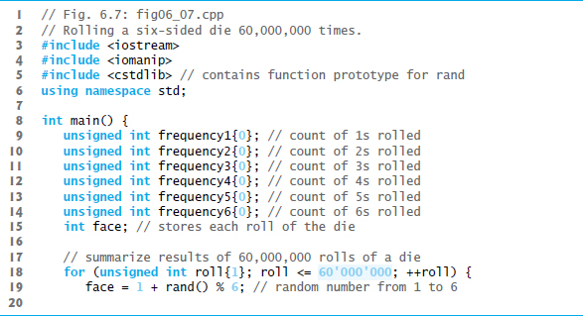
Figure 6.7 Rolling a Six-Sided Die 60,000,000 Times (1 of 3)

Slide 58
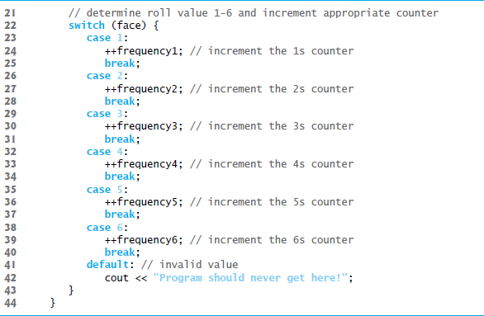
Figure 6.7 Rolling a Six-Sided Die 60,000,000 Times (2 of 3)

Slide 59
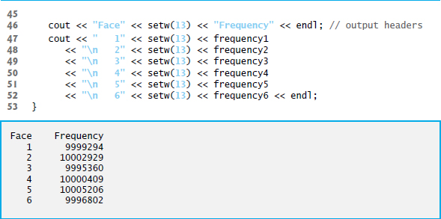
Figure 6.7 Rolling a Six-Sided Die 60,000,000 Times (3 of 3)

Slide 60
Error-Prevention Tip 6.4
Provide a default case in a switch to catch errors even if you are absolutely, positively certain that you have no bugs!

Slide 61
6.7.2 Rolling a Six-Sided Die 60,000,000 Times (2 of 2)
Prior to C++14, you’d represent the integer value 60,000,000 as 60000000 in a program.
To make numeric literals more readable, C++14 allows you to insert between groups of digits in numeric literals the digit separator ‘ (a single-quote character)
60’000’000 represents the integer value 60,000,000.

Slide 62
6.7.3 Randomizing the Random-Number Generator with Srand (1 of 2)
Executing the program of Figure 6.6 again produces exactly the same sequence of values.
Repeatability is an important characteristic of rand.
Can help with testing and debugging.
rand generates pseudorandom numbers.
a sequence of numbers that appears to be random.
sequence repeats itself each time the program executes.

Slide 63
Error-Prevention Tip 6.5
When debugging a simulation program, random-number repeatability is essential for proving that corrections to the program work properly.

Slide 64
6.7.3 Randomizing the Random-Number Generator with srand (2 of 2)
Once a program has been debugged, it can be conditioned to produce a different sequence of random numbers for each execution.
This is called randomizing and is accomplished with the C++ Standard Library function srand.
Takes an unsigned integer argument and seeds rand to produce a different sequence of random numbers for each execution.

Slide 65
6.7 Case Study: Random Number Generation (3 of 3)
Seeding the Random Number Generator with srand
Figure 6.8 demonstrates function srand.

Slide 66
Software Engineering Observation 6.4
Ensure that your program seeds the random-number generator differently (and only once) each time the program executes; otherwise, an attacker would easily be able to determine the sequence of pseudorandom numbers that would be produced.

Slide 67
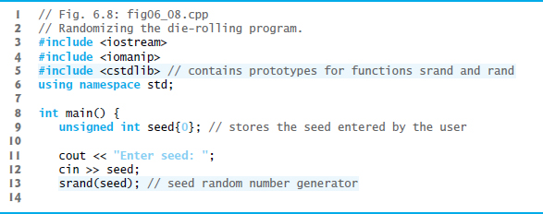
Figure 6.8 Randomizing the Die-Rolling Program (1 of 3)

Slide 68
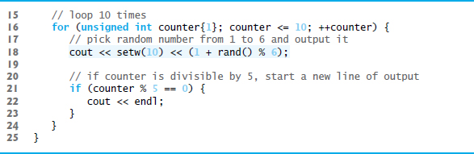
Figure 6.8 Randomizing the Die-Rolling Program (2 of 3)

Slide 69

Figure 6.8 Randomizing the Die-Rolling Program (3 of 3)

Slide 70
6.7.4 Seeding the Random-Number Generator with the Current Time
To randomize without having to enter a seed
Causes the computer to read its clock to obtain the value for the seed.
Function time (with the argument 0 as written in the preceding statement) returns the current time as the number of seconds since January 1, 1970, at midnight Greenwich Mean Time (G M T).
The function prototype for time is in <ctime>.

Slide 71
6.7.5 Scaling and Shifting Random Numbers
To produce random numbers in a specific range use:
shiftingValue is equal to the first number in the desired range of consecutive integers
scalingFactor is equal to the width of the de-sired range of consecutive integers.

Slide 72
6.8 Case Study: Game of Chance; Introducing Enum (1 of 6)
Rules of Craps
A player rolls two dice. Each die has six faces.
Faces contain 1, 2, 3, 4, 5 and 6 spots.
After the dice have come to rest, the sum of the spots on the two upward faces is calculated.
If the sum is 7 or 11 on the first roll, the player wins.
If the sum is 2, 3 or 12 on the first roll (called “craps”), the player loses (i.e., the “house” wins).
If the sum is 4, 5, 6, 8, 9 or 10 on the first roll, then that sum becomes the player’s “point.”
To win, continue rolling until you “make your point.”
You lose by rolling a 7 before making the point.
The program in Figure 6.9 simulates the game.

Slide 73
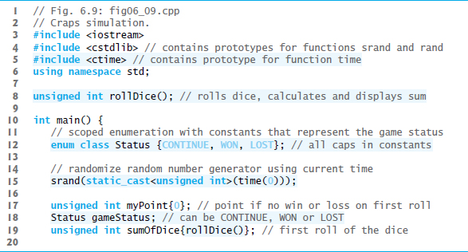
Figure 6.9 Craps Simulation (1 of 5)

Slide 74
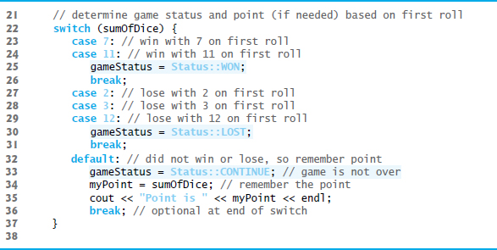
Figure 6.9 Craps Simulation (2 of 5)

Slide 75
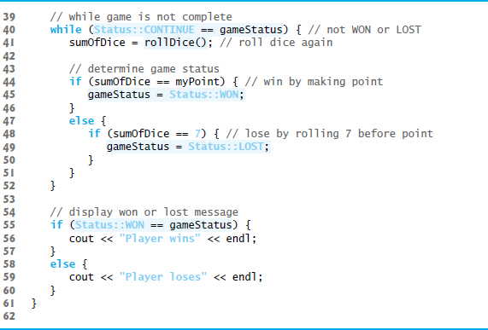
Figure 6.9 Craps Simulation (3 of 5)

Slide 76
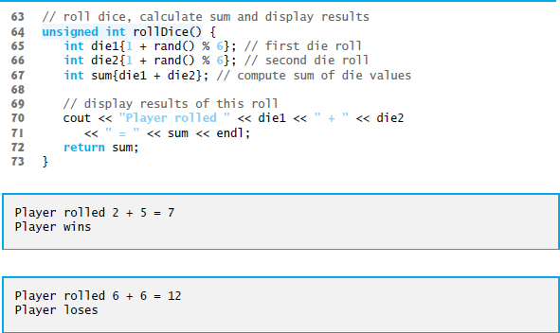
Figure 6.9 Craps Simulation (4 of 5)

Slide 77
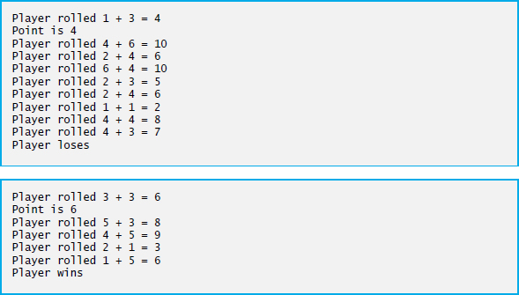
Figure 6.9 Craps Simulation (5 of 5)

Slide 78
6.8 Case Study: Game of Chance; Introducing enum (2 of 6)
A scoped enumeration (C++11) introduced by enum class and followed by a type name, is a set of identifiers representing integer constants.
The values of these enumeration constants start at 0, unless specified otherwise, and increment by 1.
The identifiers must be unique, but separate enumeration constants can have the same value.
Variables of an enum class can be assigned only one of the values declared in the enumeration.

Slide 79
Good Programming Practice 6.2
By convention, you should capitalize the first letter of an enum class’s name.

Slide 80
Good Programming Practice 6.3
Use only uppercase letters in enumeration constant names. This makes these constants stand out in a program and reminds you that enumeration constants are not variables.

Slide 81
6.8 Case Study: Game of Chance; Introducing enum (3 of 6)
To reference a scoped enum constant, qualify it with the type name and the scope-resolution operator (::), as in Status::CONTINUE.

Slide 82
Error-Prevention Tip 6.6
Qualifying an enum class’s constant with its typename and :: explicitly identifies the constant as being in the scope of the specified enum class. If another enum class contains the same identifier for one of its constants, it’s always clear which version of the constant is being used, because the typename and :: are required.

Slide 83
6.8 Case Study: Game of Chance; Introducing enum (4 of 6)
Another popular enumeration is
creates user-defined type Months with enumeration constants representing the months of the year.
The first value in the preceding enumeration is explicitly set to 1, so the remaining values increment from 1, resulting in the values 1 through 12.
Any enumeration constant can be assigned an integer value in the enumeration definition.

Slide 84
Error-Prevention Tip 6.7
Use unique values for an enum’s constants to help prevent hard-to-find logic errors.

Slide 85
6.8 Case Study: Game of Chance; Introducing enum (5 of 6)
Prior to C++11, enumerations were defined with enum (unscoped enums)
Problem: multiple enums may contain the same identifiers.
Using such enums in the same program can lead to naming collisions and logic errors.

Slide 86
Error-Prevention Tip 6.8t
Use scoped enums to avoid the potential naming conflicts that can occur with unscoped enum constants.

Slide 87
6.8 Case Study: Game of Chance; Introducing enum (6 of 6)
Enumeration constants are represented as integers.
An unscoped enum’s underlying integral type depends on its constants’ values—the type is guaranteed to be large enough to store the constant values specified.
A scoped enum’s underlying integral type is int.
You to specify a scoped enum’s underlying integral type by following the enum’s type name with a colon (:) and the integral type.
We can specify that the constants in the enum class Status should have type unsigned int, as in

Slide 88
Common Programming Error 6.5
A compilation error occurs if an enum constant’s value is outside the range that can be represented by the enum’s underlying type.

Slide 89
6.9 C++11 Random Numbers (1 of 4)
According to C E R T, function rand does not have “good statistical properties” and can be predictable, which makes programs that use rand less secure (C E R T guideline M S C 3 0-C P P).
C++11 provides a new, more secure library of random-number capabilities that can produce nondeterministic random numbers that can’t be predicted.
Such random-number generators are used in simulations and security scenarios where predictability is undesirable.
New capabilities are located in the C++ Standard Library’s <random> header.

Slide 90
6.9 C++11 Random Numbers (2 of 4)
For flexibility based on how random numbers are used in programs, C++11 provides many classes that represent various random-number generation engines and distributions.
An engine implements a random-number generation algorithm that produce pseudorandom numbers.
A distribution controls the range of values produced by an engine, the types of those values (e.g., int, double, etc.) and the statistical properties of the values.
uniform_int_distribution evenly distributes pseudorandom integers over a specified range of values.

Slide 91
6.9 C++11 Random Numbers (3 of 4)
Rolling a Six-Sided Die
Figure 6.10 uses the default_random_engine and the uniform_int_distribution to roll a six-sided die.
default_random_engine object named engine.
Its constructor argument seeds the random-number generation engine with the current time.
If you don’t pass a value to the constructor, the default seed will be used and the program will produce the same sequence of numbers each time it executes.
randomInt—a uniform_int_distribution object that produces unsigned int values (as specified by <unsigned int>) in the range 1 to 6 (as specified by the constructor arguments).

Slide 92
6.9 C++11 Random Numbers (4 of 4)
The expression randomInt(engine) returns one unsigned int value in the range 1 to 6.
The notation <unsigned int> indicates that uniform_int_distribution is a class template.
In this case, any integer type can be specified in the angle brackets (< and >).
In Chapter 18, we discuss how to create class templates and various other chapters show how to use existing class templates from the C++ Standard Library.
For now, you should feel comfortable using class template uniform_int_distribution by mimicking the syntax shown in the example.

Slide 93
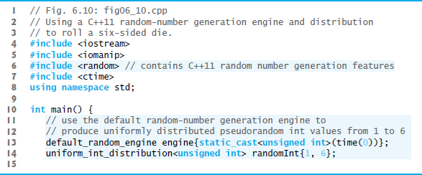
Figure 6.10 Using a C++11 Random-Number Generation Engine and Distribution to Roll a Six-Sided Die (1 of 2)

Slide 94
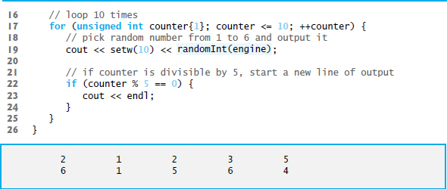
Figure 6.10 Using a C++11 Random-Number Generation Engine and Distribution to Roll a Six-Sided Die (2 of 2)

Slide 95
6.10 Scope Rules (1 of 4)
The portion of the program where an identifier can be used is known as its scope.
This section discusses
block scope
global namespace scope

Slide 96
6.10 Scope Rules (2 of 4)
Identifiers declared inside a block have block scope, which begins at the identifier’s declaration and ends at the terminating right brace (}) of the enclosing block.
Local variables have block scope, as do function parameters.
Any block can contain variable declarations.
In nested blocks, if an identifier in an outer block has the same name as an identifier in an inner block, the one in the outer block is “hidden” until the inner block terminates.
The inner block “sees” its own local variable’s value and not that of the enclosing block’s identically named variable.

Slide 97
Common Programming Error 6.6
Accidentally using the same name for an identifier in an inner block that’s used for an identifier in an outer block, when in fact you want the identifier in the outer block to be active for the duration of the inner block, is typically a logic error.

Slide 98
Error-Prevention Tip 6.9
Avoid variable names in inner scopes that hide names in outer scopes. Most compilers will warn you about this issue.

Slide 99
6.10 Scope Rules (3 of 4)
An identifier declared outside any function or class has global namespace scope.
“known” in all functions from the point at which it’s declared until the end of the file.
Function definitions, function prototypes placed outside a function, class definitions and global variables all have global namespace scope.
Global variables are created by placing variable declarations outside any class or function definition. Such variables retain their values throughout a program’s execution.

Slide 100
Software Engineering Observation 6.5
Declaring a variable as global rather than local allows unintended side effects to occur when a function that does not need access to the variable accidentally or maliciously modifies it. This is another example of the principle of least privilege—except for truly global resources such as cin and cout, global variables should be avoided. In general, variables should be declared in the narrowest scope in which they need to be accessed.

Slide 101
Software Engineering Observation 6.6
Variables used only in a particular function should be declared as local variables in that function rather than as global variables.

Slide 102
6.10 Scope Rules (4 of 4)
Scope Demonstration
The program of Figure 6.11 demonstrates scoping issues with global variables, automatic local variables and static local variables.

Slide 103
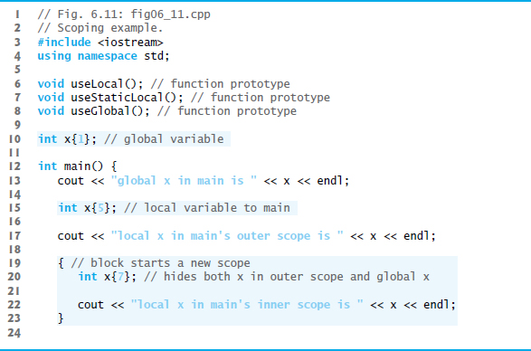
Figure 6.11 Scoping Example (1 of 4)

Slide 104
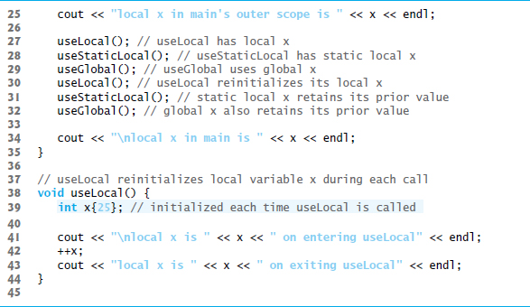
Figure 6.11 Scoping Example (2 of 4)

Slide 105
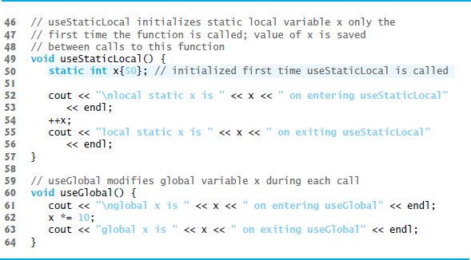
Figure 6.11 Scoping Example (3 of 4)

Slide 106
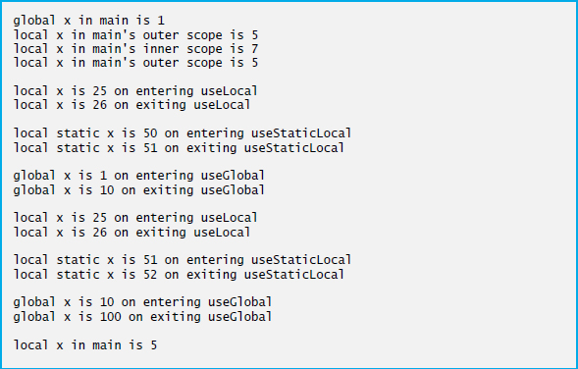
Figure 6.11 Scoping Example (4 of 4)

Slide 107
6.11 Function Call Stack and Activation Records (1 of 5)
To understand how C++ performs function calls, we first need to consider a data structure (i.e., collection of related data items) known as a stack.
Analogous to a pile of dishes.
When a dish is placed on the pile, it’s normally placed at the top—referred to as pushing.
Similarly, when a dish is removed from the pile, it’s normally removed from the top—referred to as popping.
Last-in, first-out (L I F O) data structures—the last item pushed (inserted) is the first item popped (removed).

Slide 108
6.11 Function Call Stack and Activation Records (2 of 5)
Function-Call Stack
One of the most important mechanisms for computer science students to understand is the function call stack (or program execution stack).
supports the function call/return mechanism.
Also supports the creation, maintenance and destruction of each called function’s automatic variables.

Slide 109
6.11 Function Call Stack and Activation Records (3 of 5)
Stack Frames
Each function eventually must return control to the function that called it.
Each time a function calls another function, an entry is pushed onto the function call stack.
This entry, called a stack frame or an activation record, contains the return address that the called function needs in order to return to the calling function.

Slide 110
6.11 Function Call Stack and Activation Records (4 of 5)
Automatic Local Variables and Stack Frames
When a function call returns, the stack frame for the function call is popped, and control transfers to the return address in the popped stack frame.
Stack Overflow
The amount of memory in a computer is finite, so only a certain amount of memory can be used to store activation records on the function call stack.
If more function calls occur than can have their activation records stored on the function call stack, an a fatal error known as stack overflow occurs.

Slide 111
6.11 Function Call Stack and Activation Records (5 of 5)
Function Call Stack in Action
Now let’s consider how the call stack supports the operation of a square function called by main (Figure 6.12).
First the operating system calls main—this pushes an activation record onto the stack (shown in Figure 6.13).
The activation record tells main how to return to the operating system (i.e., transfer to return address R1) and contains the space for main’s automatic variable (i.e., a, which is initialized to 10).

Slide 112
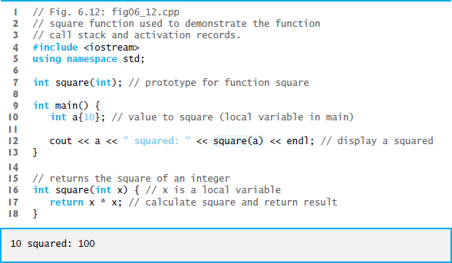
Figure 6.12 square Function Used to Demonstrate the Function-Call Stack and Activation Records

Slide 113
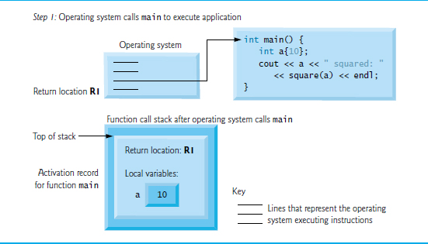
Figure 6.13 Function-Call Stack After the Operating System Calls main to Execute the Program

Slide 114
6.12 Function Call Stack and Activation Records (1 of 2)
Function main—before returning to the operating system—now calls function square in line 12 of Figure 6.12.
This causes a stack frame for square (lines 16–18) to be pushed onto the function call stack (Figure 6.14).
This stack frame contains the return address that square needs to return to main (i.e., R2) and the memory for square’s automatic variable (i.e., x).

Slide 115
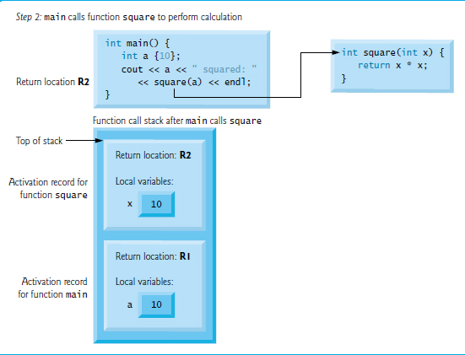
Figure 6.14 Function-Call Stack After main Calls square to Perform the Calculation

Slide 116
6.12 Function Call Stack and Activation Records (2 of 2)
After square calculates the square of its argument, it needs to return to main—and no longer needs the memory for its automatic variable x. So square’s stack frame is popped from the stack—giving square the return location in main (i.e., R2) and losing square’s automatic variable.
Figure 6.15 shows the function call stack after square’s activation record has been popped.

Slide 117
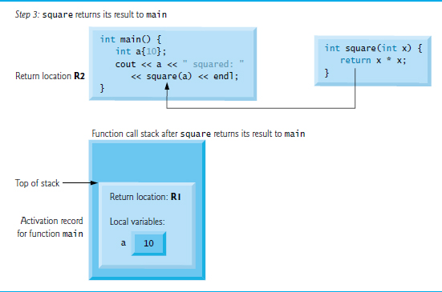
Figure 6.15 Function-Call Stack After Function square Returns to main

Slide 118
6.12 Inline Functions
C++ provides inline functions to help reduce function call overhead.
Placing the qualifier inline before a function’s return type in the function definition advises the compiler to generate a copy of the function’s code in every place where the function is called (when appropriate) to avoid a function call.
This often makes the program larger.
Reusable inline functions are typically placed in headers, so that their definitions can be included in each source file that uses them.

Slide 119
Software Engineering Observation 6.7
If you change the definition of an inline function, you must recompile all of that function’s clients.

Slide 120
Performance Tip 6.1
Compilers can inline code for which you have not explicitly used the inline keyword. Today’s optimizing compilers are so sophisticated that it’s best to leave inlining decisions to the compiler.

Slide 121
6.14 Inline Functions
Figure 6.16 uses inline function cube (lines 9–11) to calculate the volume of a cube.
Keyword const in function cube’s parameter list (line 9) tells the compiler that the function does not modify variable side.
This ensures that side’s value is not changed by the function during the calculation.

Slide 122
Software Engineering Observation 6.8
The const qualifier should be used to enforce the principle of least privilege. Using this principle to properly design software can greatly reduce debugging time and improper side effects and can make a program easier to modify and maintain.

Slide 123
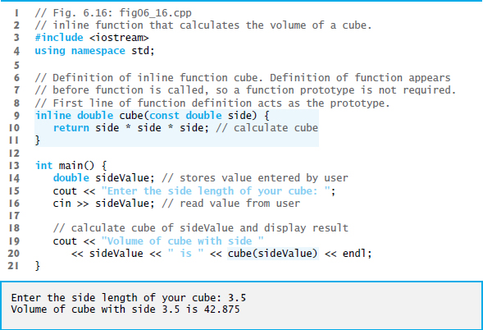
Figure 6.16 inline Function That Calculates the Volume of a Cube

Slide 124
6.13 References and Reference Parameters
Two ways to pass arguments to functions in many programming languages are pass-by-value and pass-by-reference.
When an argument is passed by value, a copy of the argument’s value is made and passed (on the function call stack) to the called function.
Changes to the copy do not affect the original variable’s value in the caller.
To specify a reference to a constant, place the const qualifier before the type specifier in the parameter declaration.

Slide 125
Performance Tip 6.2
One disadvantage of pass-by-value is that, if a large data item is being passed, copying that data can take a considerable amount of execution time and memory space.

Slide 126
6.15 References and Reference Parameters (1 of 4)
With pass-by-reference, the caller gives the called function the ability to access the caller’s data directly, and to modify that data.
A reference parameter is an alias for its corresponding argument in a function call.
To indicate that a function parameter is passed by reference, simply follow the parameter’s type in the function prototype by an ampersand (&); use the same convention when listing the parameter’s type in the function header.
Figure 6.17 compares pass-by-value and pass-by-reference with reference parameters.

Slide 127
Performance Tip 6.3
Pass-by-reference is good for performance reasons, because it can eliminate the pass-by-value overhead of copying large amounts of data.

Slide 128
Software Engineering Observation 6.9
Pass-by-reference can weaken security; the called function can corrupt the caller’s data.

Slide 129
Common Programming Error 6.7
Because reference parameters are mentioned only by name in the body of the called function, you might inadvertently treat reference parameters as pass-by-value parameters. This can cause unexpected side effects if the original variables are changed by the function.

Slide 130
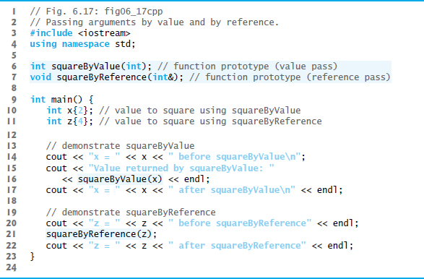
Figure 6.17 Passing Arguments by Value and by Reference (1 of 2)

Slide 131
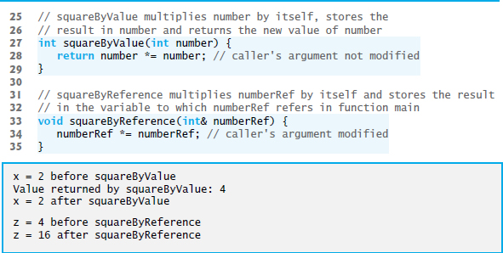
Figure 6.17 Passing Arguments by Value and by Reference (2 of 2)

Slide 132
6.15 References and Reference Parameters (2 of 4)
References can also be used as aliases for other variables within a function.
Reference variables must be initialized in their declarations and cannot be reassigned as aliases to other variables.
Once a reference is declared as an alias for another variable, all operations supposedly performed on the alias are actually performed on the original variable.

Slide 133
6.15 References and Reference Parameters (3 of 4)
To specify that a reference parameter should not be allowed to modify the corresponding argument, place the const qualifier before the type name in the parameter’s declaration.
string objects can be large, so they (and objects in general) should be passed to functions by reference.

Slide 134
Performance Tip 6.4
For passing large objects, use a const reference parameter to simulate the appearance and security of pass-by-value and avoid the overhead of passing a copy of the large object.

Slide 135
6.15 References and Reference Parameters (4 of 4)
Functions can return references, but this can be dangerous.
When returning a reference to a variable declared in the called function, the variable should be declared static in that function.

Slide 136
Common Programming Error 6.8
Returning a reference to a local variable in a called function is a logic error for which compilers typically issue a warning. Compilation warnings indicate potential problems, so most software-engineering teams have policies requiring code to compile without warnings.

Slide 137
6.14 Default Arguments (1 of 2)
It common for a program to invoke a function repeatedly with the same argument value for a particular parameter.
Can specify that such a parameter has a default argument, i.e., a default value to be passed to that parameter.
When a program omits an argument for a parameter with a default argument in a function call, the compiler rewrites the function call and inserts the default value of that argument.
Figure 6.18 demonstrates using default arguments to calculate a box’s volume.

Slide 138
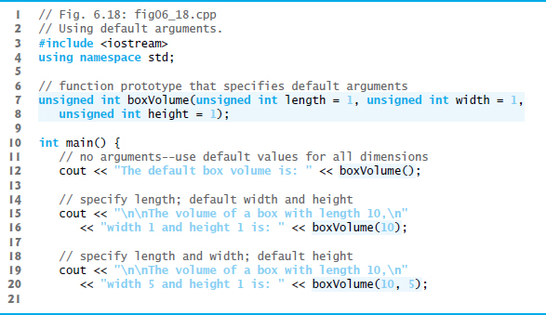
Figure 6.18 Using Default Arguments (1 of 2)

Slide 139
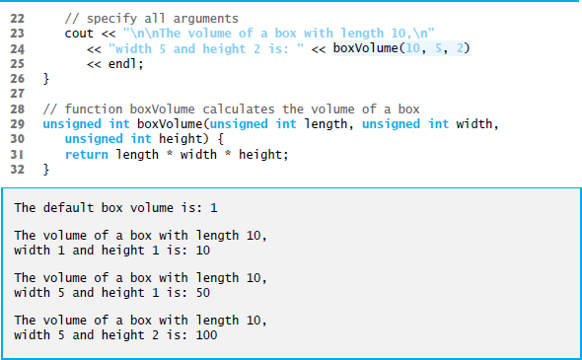
Figure 6.18 Using Default Arguments (2 of 2)

Slide 140
6.14 Default Arguments (2 of 2)
Default arguments must be the rightmost (trailing) arguments in a function’s parameter list.
When calling a function with two or more default arguments, if an omitted argument is not the rightmost argument, then all arguments to the right of that argument also must be omitted.
Default arguments must be specified with the first occurrence of the function name—typically, in the function prototype.
Default values can be any expression, including constants, global variables or function calls. Default arguments also can be used with inline functions.

Slide 141
Good Programming Practice 6.4
Using default arguments can simplify writing function calls. However, some programmers feel that explicitly specifying all arguments is clearer.

Slide 142
6.15 Unary Scope Resolution Operator
C++ provides the unary scope resolution operator (::) to access a global variable when a local variable of the same name is in scope.
Using the unary scope resolution operator (::) with a given variable name is optional when the only variable with that name is a global variable.
Figure 6.19 shows the unary scope resolution operator with local and global variables of the same name.

Slide 143
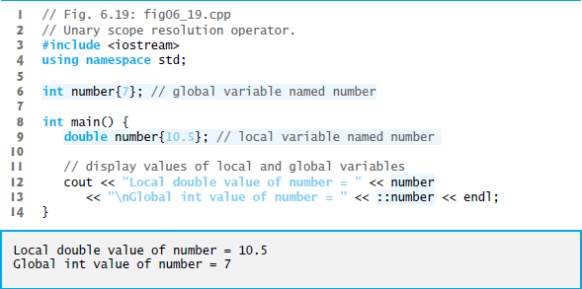
Figure 6.19 Unary Scope Resolution Operator

Slide 144
Good Programming Practice 6.5
Always using the unary scope resolution operator (::) to refer to global variables (even if there is no collision with a local-variable name) makes it clear that you’re intending to access a global variable rather than a local variable.

Slide 145
Software Engineering Observation 6.10
Always using the unary scope resolution operator (::) to refer to global variables makes programs easier to modify by reducing the risk of name collisions with nonglobal variables.

Slide 146
Error-Prevention Tip 6.10
Always using the unary scope resolution operator (::) to refer to a global variable eliminates logic errors that might occur if a nonglobal variable hides the global variable.

Slide 147
Error-Prevention Tip 6.11
Avoid using variables of the same name for different purposes in a program. Although this is allowed in various circumstances, it can lead to errors.

Slide 148
6.16 Function Overloading (1 of 4)
C++ enables several functions of the same name to be defined, as long as they have different signatures.
This is called function overloading.
The C++ compiler selects the proper function to call by examining the number, types and order of the arguments in the call.
Function overloading is used to create several functions of the same name that perform similar tasks, but on different data types.

Slide 149
Good Programming Practice 6.6
Overloading functions that perform closely related tasks can make programs more readable and understandable.

Slide 150
6.16 Function Overloading (2 of 4)
Figure 6.20 uses overloaded square functions to calculate the square of an int and the square of a double.

Slide 151
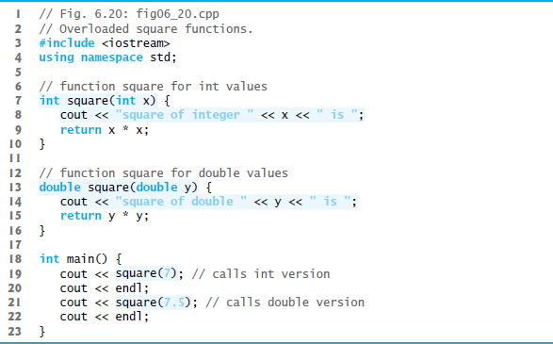
Figure 6.20 Overloaded square Functions (1 of 2)

Slide 152
Figure 6.20 Overloaded square Functions (2 of 2)

Slide 153
6.16 Function Overloading (3 of 4)
How the Compiler Differentiates Among Overloaded Functions
Overloaded functions are distinguished by their signatures.
A signature is a combination of a function’s name and its parameter types (in order).
The compiler encodes each function identifier with the types of its parameters (sometimes referred to as name mangling or name decoration) to enable type-safe linkage.
Ensures that the proper overloaded function is called and that the types of the arguments conform to the types of the parameters.
Figure 6.21 was compiled with G N U C++.
Rather than showing the execution output of the program, we show the mangled function names produced in assembly language by G N U C++.

Slide 154
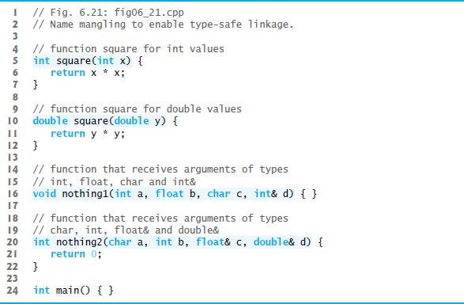
Figure 6.21 Name Mangling to Enable Type-Safe Linkage (1 of 2)

Slide 155
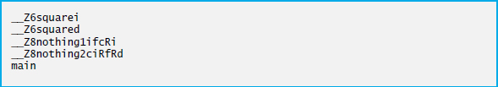
Figure 6.21 Name Mangling to Enable Type-Safe Linkage (2 of 2)

Slide 156
6.16 Function Overloading (4 of 4)
For G N U C++, each mangled name (other than main) begins with two underscores (__) followed by the letter Z, a number and the function name.
The number specifies how many characters are in the function’s name.
The compiler distinguishes the two square functions by their parameter lists—one specifies i for int and the other d for double.
The return types of the functions are not specified in the mangled names.
Overloaded functions can have different return types, but if they do, they must also have different parameter lists.
Function-name mangling is compiler specific.

Slide 157
Common Programming Error 6.9
Creating overloaded functions with identical parameter lists and different return types is a compilation error.

Slide 158
Common Programming Error 6.10
A function with default arguments omitted might be called identically to another overloaded function; this is a compilation error. For example, having a program that contains both a function that explicitly takes no arguments and a function of the same name that contains all default arguments results in a compilation error when an attempt is made to use that function name in a call passing no arguments. The compiler cannot determine which version of the function to choose.

Slide 159
6.17 Function Templates (1 of 3)
If the program logic and operations are identical for each data type, overloading may be performed more compactly and conveniently by using function templates.
You write a single function template definition.
Given the argument types provided in calls to this function, C++ automatically generates separate function template specializations to handle each type of call appropriately.

Slide 160
6.17 Function Templates (2 of 3)
Figure 6.22 defines a maximum function that determines the largest of three values.
All function template definitions begin with the template keyword followed by a template parameter list enclosed in angle brackets (< and >).
Every parameter in the template parameter list is preceded by keyword typename or keyword class.
The type parameters are placeholders for fundamental types or user-defined types.
Used to specify the types of the function’s parameters, to specify the function’s return type and to declare variables within the body of the function definition.

Slide 161
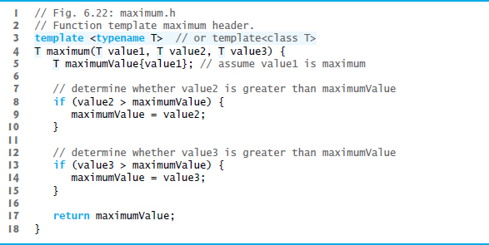
Figure 6.22 Function Template maximum Header

Slide 162
6.19 Function Templates
Figure 6.23 uses the maximum function template to determine the largest of three int values, three double values and three char values, respectively.
Separate functions are created as a result of the calls—expecting three int values, three double values and three char values, respectively.

Slide 163
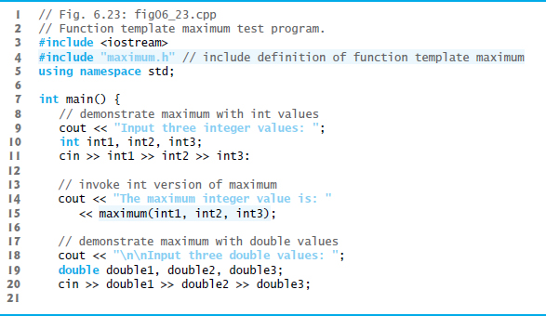
Figure 6.23 Function Template maximum Test Program (1 of 2)

Slide 164
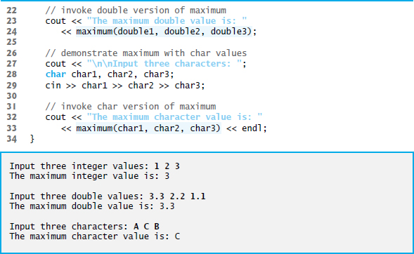
Figure 6.23 Function Template maximum Test Program (2 of 2)

Slide 165
6.18 Recursion (1 of 7)
A recursive function is a function that calls itself, either directly, or indirectly (through another function).
Recursive problem-solving approaches have a number of elements in common.
A recursive function is called to solve a problem.
The function actually knows how to solve only the simplest case(s), or so-called base case(s).
If the function is called with a base case, the function simply returns a result.
If the function is called with a more complex problem, it typically divides the problem into two conceptual pieces—a piece that the function knows how to do and a piece that it does not know how to do.
This new problem looks like the original, so the function calls a copy of itself to work on the smaller problem—this is referred to as a recursive call and is also called the recursion step.

Slide 166
Common Programming Error 6.11
Omitting the base case or writing the recursion step incorrectly so that it does not converge on the base case causes an infinite recursion error, typically causing a stack overflow. This is analogous to the problem of an infinite loop in an iterative (nonrecursive) solution.

Slide 167
6.18 Recursion (2 of 7)
The recursion step often includes the key-word return, because its result will be combined with the portion of the problem the function knew how to solve to form the result passed back to the original caller, possibly main.
The recursion step executes while the original call to the function is still “open,” i.e., it has not yet finished executing.
The recursion step can result in many more such recursive calls.

Slide 168
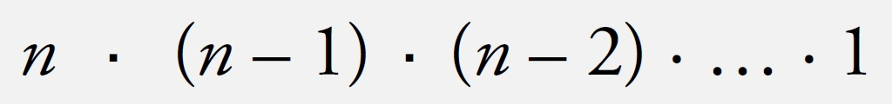
6.18 Recursion (3 of 7)
Factorial
The factorial of a nonnegative integer n, written n! (and pronounced “n factorial”), is the product
with 1! equal to 1, and 0! defined to be 1.

Slide 169
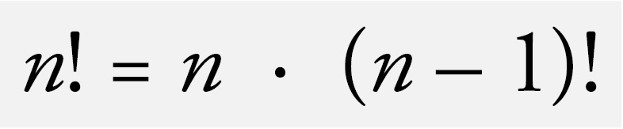
6.18 Recursion (4 of 7)
Iterative Factorial
The factorial of an integer, number, greater than or equal to 0, can be calculated iteratively (nonrecursively) by using a loop.
Recursive Factorial
A recursive definition of the factorial function is arrived at by observing the following algebraic relationship:

Slide 170
6.18 Recursion (5 of 7)
Evaluating 5!
The evaluation of 5! would proceed as shown in Figure 6.24, which illustrates how the succession of recursive calls proceeds until 1! is evaluated to be 1, terminating the recursion.
Figure 6.24(b) shows the values returned from each recursive call to its caller until the final value is calculated and returned.

Slide 171
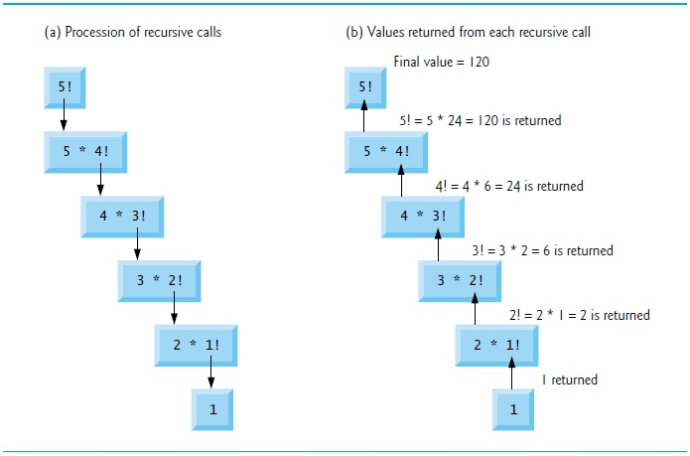
Figure 6.24 Recursive Evaluation of 5!

Slide 172
6.18 Recursion (6 of 7)
Using a Recursive factorial Function to Calculate Factorials
Figure 6.25 uses recursion to calculate and print the factorials of the integers 0–10.

Slide 173
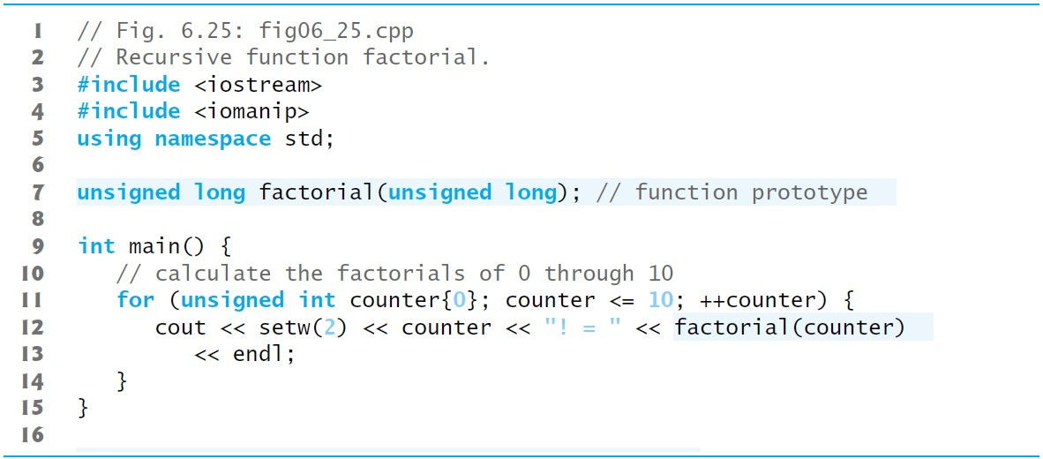
Figure 6.25 Recursive Function factorial (1 of 2)

Slide 174
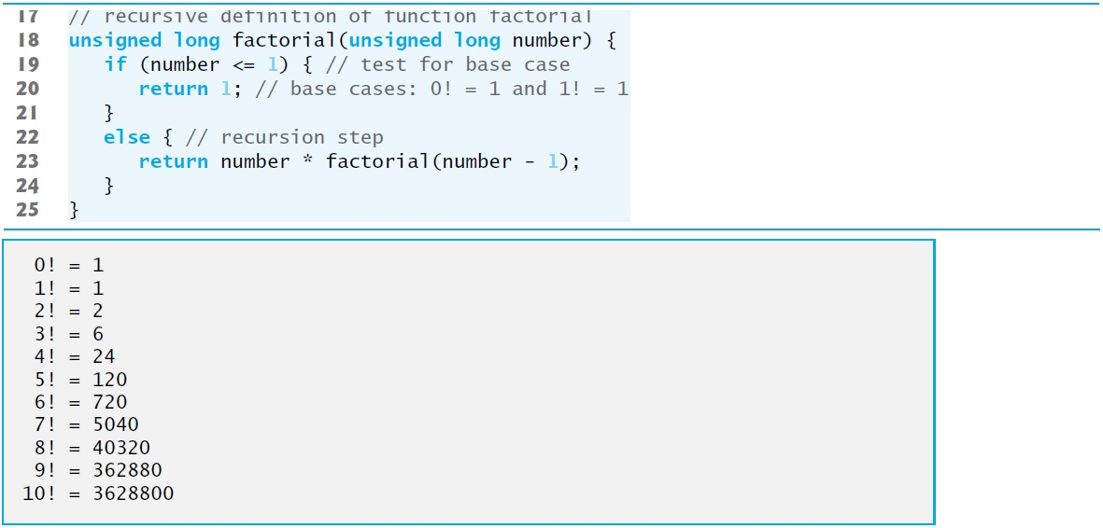
Figure 6.25 Recursive Function factorial (2 of 2)

Slide 175
6.18 Recursion (7 of 7)
C++11 Type unsigned long long int
C++11’s unsigned long long int type (which can be abbreviated as unsigned long long ) on some systems enables you to store values in at least 8 bytes (64 bits) which can hold numbers as large as 18,446,744,073,709,551,615.

Slide 176
6.19 Example Using Recursion: Fibonacci Series (1 of 3)
The Fibonacci series
0, 1, 1, 2, 3, 5, 8, 13, 21, …
begins with 0 and 1 and has the property that each subsequent Fibonacci number is the sum of the previous two Fibonacci numbers.
The series occurs in nature and, in particular, describes a form of spiral.
The ratio of successive Fibonacci numbers converges on a constant value of 1.618….
This frequently occurs in nature and has been called the golden ratio or the golden mean.
Humans tend to find the golden mean aesthetically pleasing.

Slide 177
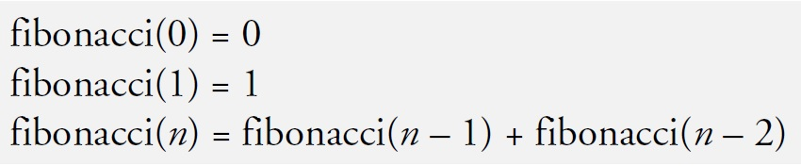
6.19 Example Using Recursion: Fibonacci Series (2 of 3)
Recursive Fibonacci Definition
The Fibonacci series can be defined recursively as follows:
The program of Figure 6.26 calculates the nth Fibonacci number recursively by using function fibonacci.

Slide 178
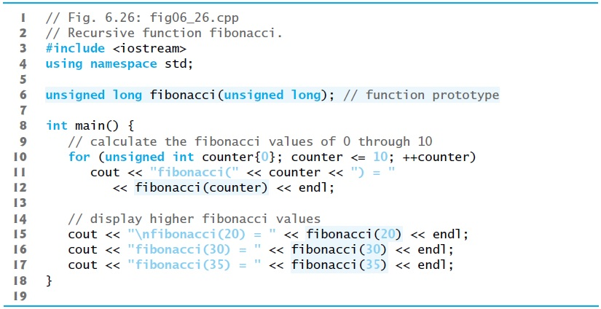
Figure 6.26 Recursive Function fibonacci (1 of 3)

Slide 179
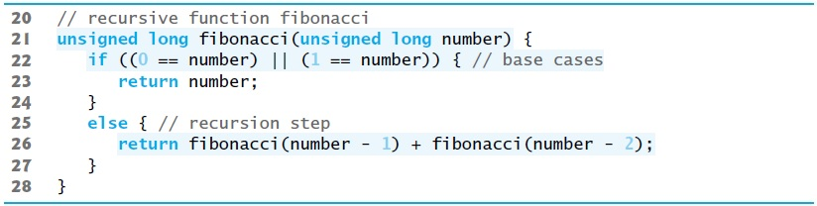
Figure 6.26 Recursive Function fibonacci (2 of 3)

Slide 180
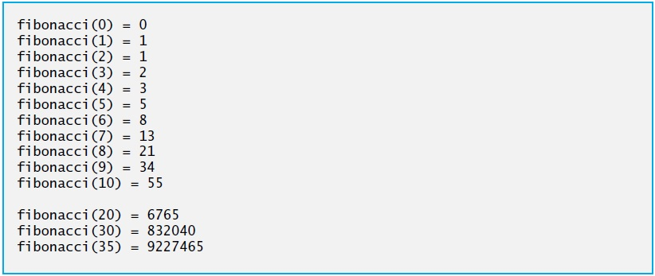
Figure 6.26 Recursive Function fibonacci (3 of 3)

Slide 181
6.19 Example Using Recursion: Fibonacci Series (3 of 3)
Figure 6.27 shows how function fibonacci would evaluate fibonacci(3).
Figure raises interesting issues about the order in which C++ compilers evaluate the operands of operators.
Separate issue from the order in which operators are applied to their operands, namely, the order dictated by the rules of operator precedence and associativity.
Most programmers assume that operands are evaluated left to right.
C++ does not specify the order in which the operands of most operators (including +) are to be evaluated.
Therefore, you must make no assumption about the order in which these calls execute.

Slide 182
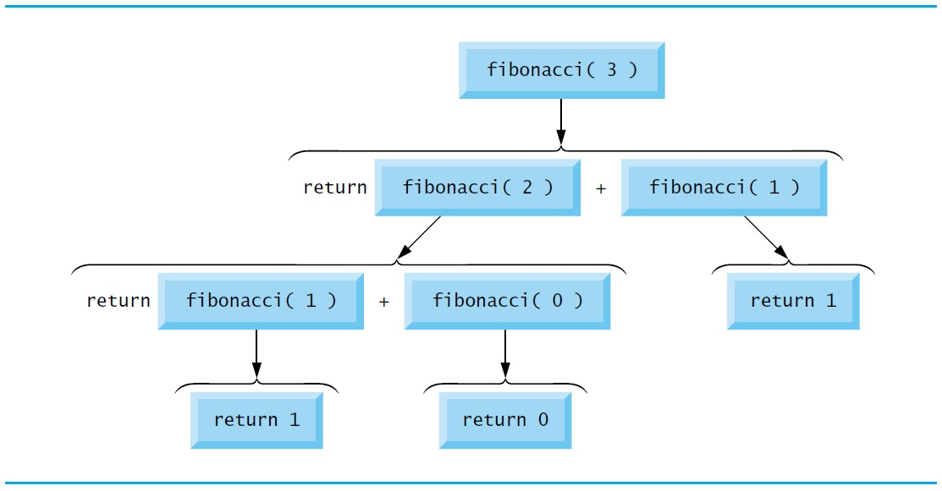
Figure 6.27 Set of Recursive Calls to Function fibonacci

Slide 183
Portability Tip 6.3
Programs that depend on the order of evaluation of the operands of operators other than
and the comma (,) operator can function differently with different compilers and can lead to logic errors.

Slide 184
Common Programming Error 6.12
Writing programs that depend on the order of evaluation of the operands of operators other than
and the comma (,) operator can lead to logic errors.

Slide 185
Error-Prevention Tip 6.12
Do not depend on the order in which operands are evaluated. To ensure that side effects are applied in the correct order, break complex expressions into separate statements.

Slide 186
Common Programming Error 6.13
Recall that the
operators use short-circuit evaluation. Placing an expression with a side effect on the right side of a
operator is a logic error if that expression should always be evaluated.

Slide 187
Performance Tip 6.5
Avoid Fibonacci-style recursive programs that result in an exponential “explosion” of calls.

Slide 188
6.22 Recursion Vs. Iteration (1 of 3)
Both iteration and recursion are based on a control statement:
Iteration uses an iteration statement
Recursion uses a selection statement.
Both iteration and recursion involve iteration:
Iteration explicitly uses an iteration statement
Recursion achieves repetition through repeated function calls.
Iteration and recursion each involve a termination test:
Iteration terminates when the loop-continuation condition fails
Recursion terminates when a base case is recognized.

Slide 189
6.22 Recursion Vs. Iteration (2 of 3)
Counter-controlled iteration and recursion both gradually approach termination:
Iteration modifies a counter until the counter assumes a value that makes the loop-continuation condition fail
Recursion produces simpler versions of the original problem until the base case is reached.
Both iteration and recursion can occur infinitely:
An infinite loop occurs with iteration if the loop-continuation test never becomes false
Infinite recursion occurs if the recursion step does not reduce the problem during each recursive call in a manner that converges on the base case.

Slide 190
6.22 Recursion Vs. Iteration (3 of 3)
To illustrate the differences between iteration and recursion, Figure 6.28 presents an iterative solution to the factorial problem.

Slide 191
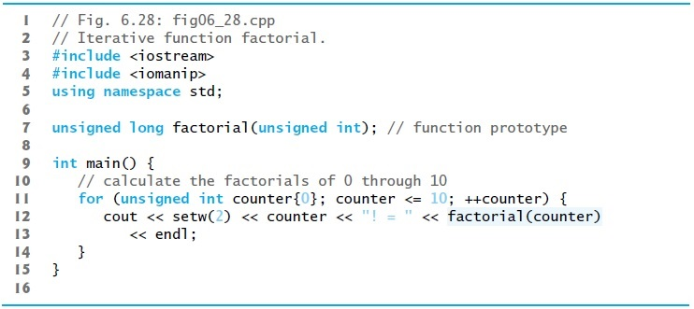
Figure 6.28 Iterative Function factorial (1 of 2)

Slide 192
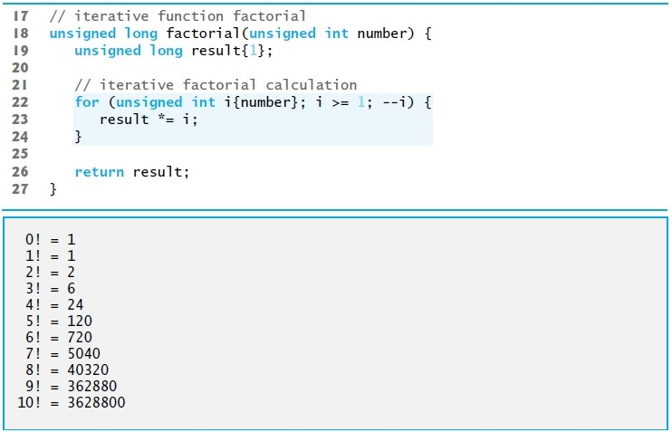
Figure 6.28 Iterative Function factorial (2 of 2)

Slide 193
Software Engineering Observation 6.11
Any problem that can be solved recursively can also be solved iteratively (nonrecursively). A recursive approach is normally chosen when the recursive approach more naturally mirrors the problem and results in a program that’s easier to understand and debug. Another reason to choose a recursive solution is that an iterative solution may not be apparent when a recursive solution is.

Slide 194
Performance Tip 6.6
Avoid using recursion in performance situations. Recursive calls take time and consume additional memory.

Slide 195
Common Programming Error 6.14
Accidentally having a nonrecursive function call itself, either directly or indirectly (through another function), is a logic error.

Slide 196
Figure 6.29 Summary of Recursion Examples and Exercises in the Text (1 of 4)
Chapter 6
Location in text | Recursion examples and exercises
Section 6.18, Figure 6.25 | Factorial function
Section 6.19, Figure 6.26 | Fibonacci function
Exercise 6.36 | Recursive exponentiation
Exercise 6.38 | Towers of Hanoi
Exercise 6.40 | Visualizing recursion
Exercise 6.41 | Greatest common divisor
Exercise 6.43, Exercise 6.44 | “What does this program do?” exercise

Slide 197
Figure 6.29 Summary of Recursion Examples and Exercises in the Text (2 of 4)
Chapter 7
Location in text | Recursion examples and exercises
Exercise 7.17 | “What does this program do?” exercise
Exercise 7.20 | “What does this program do?” exercise
Exercise 7.28 | Determine whether a string is a palindrome
Exercise 7.29 | Eight Queens
Exercise 7.30 | Print an array
Exercise 7.31 | Print a string backward
Exercise 7.32 | Minimum value in an array
Exercise 7.33 | Maze traversal
Exercise 7.34 | Generating mazes randomly

Slide 198
Figure 6.29 Summary of Recursion Examples and Exercises in the Text (3 of 4)
Chapter 19
Location in text | Recursion examples and exercises
Section 19.6, Figures 19.20–19.22 | Binary tree insert
Section 19.6, Figures 19.20–19.22 | Preorder traversal of a binary tree
Section 19.6, Figures 19.20–19.22 | Inorder traversal of a binary tree
Section 19.6, Figures 19.20–19.22 | Postorder traversal of a binary tree
Exercise 19.20 | Print a linked list backward
Exercise 19.21 | Search a linked list
Exercise 19.22 | Binary tree search
Exercise 19.23 | Level order traversal of a binary tree
Exercise 19.24 | Printing tree

Slide 199
Figure 6.29 Summary of Recursion Examples and Exercises in the Text (4 of 4)
Chapter 20
Location in text | Recursion examples and exercises
Section 20.3.3, Figure 20.6 | Mergesort
Exercise 20.8 | Linear search
Exercise 20.9 | Binary search
Exercise 20.10 | Quicksort

Slide 200

Copyright

